Slide 1
Strategic Marketing Simulator 1.0 Sprint 6 review
Strategic Marketing Simulator 1.0
Team # 15
Team Members
Javier Andrial
Jeffrey Carman
Product Owner: Joseph Cilli
Project Mentor: Masoud Sadjadi

Slide 2
User Story 1
#842 Professor Feedback
Description:
Professor is able to give their feedback at the end of period for a specific Group based on their strategic decisions and their end of period comment.
Acceptance Criteria:
A period has ended
Is Admin
Tasks
This GUI should display the comment that receiving the feedback and should display any existing feedback if it exists
Professor can write their feedback and post it to the Database for a specific comment

Slide 3
User Story 2
#841 Professor Portfolio
Description:
Admin is able to download a detailed report of how Each Hotel did during the last period, as well as all the groups as a whole performed
Acceptance Criteria:
Period has ended
Student users in Game
is an Admin
Tasks
Gather relative information for the selected game and selected period and structure and print it to a downloadable PDF

Slide 4
User Story 3
#840 Comment Repository
Description:
A page where an Admin user can view all Comments for a Game’s Period.
Admin can also filter Comments by Hotel Type
Acceptance Criteria:
A period has ended
A game is Active or has finished
Game has Student users
Is an Admin user
Tasks
All comments for all games and periods should be displayed
Allow a filtering feature that will reduce the displayed comments to only the ones that match the filter

Slide 5
Goals
#842 Professor Feedback
The goal of this page is to grant the user to ability provide ‘Feedback’ on a Students end of period comments and save it to the Database for the Student to see.
#841 Professor Portfolio
The goal of this page is to provide a highly detailed downloadable PDF of a selected Game and Period
#840 Comment Repository
The Goal of this page is to display all student end of period comments in a friendly, easy to use, interface.

Slide 6
Functional Requirements 1
#842 Professor Feedback
Function requirements
User must be able to type in their Feedback
User must be able to commit their Feedback to the database
User must be logged into the system as an admin to access this feature
Non function requirements
Displays current set Feedback
Appearance coheres to the style of the website

Slide 7
Functional Requirements 2
#841 Professor Portfolio
Function requirements
User must be able to choose a Game and Period
User must be able to generate a PDF for select Game/Period
User must be logged into the system as an admin to access this feature
Non function requirements
PDF is visually appealing and contains appropriate labels

Slide 8
Functional Requirements 3
#840 Comment Repository
Function requirements
User must be able to view all end of period comments
User must be able to filter results
User must be logged into the system as an admin to access this feature
Non function requirements
Appearance coheres to the style of the website

Slide 9
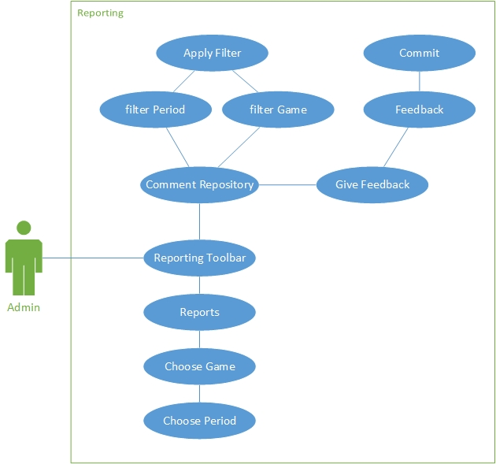
Use Case Diagram

Slide 10
Scenarios
842 Professor Feedback
Scenarios 32 - Professor provides feedback on end of period comments
A period has ended for Professor Cilli’s morning course. Professor Cilli, logs into the System and navigates to the Reporting page. Professor Cilli, selects his game and the previous period. Professor Cilli, filters the results to only display comments for a specific type of Hotel. Professor Cilli, presses the ‘Give Feedback’ button, and enters in his feedback to a Student’s end of period comment. Professor Cilli, finishes with ‘Post Feedback’ button.

Slide 11
Use Cases
Use Case 32 - Professor provides feedback on end of period comments
Actor:
Admin
Pre-Conditions:
Is logged into the System
A period has finished
A Game in the database
Normal Course:
Actor navigates to the Reporting page
Actor selects the ‘Comment Repository’ tab
Actor is Shown all the end of period comments for that Game/Period
Actor presses the ‘Provide Feedback’ button for one of the comments
Actor types in their feedback
Actor finishes by presses the ‘Post Feedback’ button
Alternative Course
If Actor filters results after Step 3
Actor can filter results by selecting a Game, Period, Hotel type
Actor continues unto step 4
Post-Condition
Actor provided Feedback
The Actors provided feedback to a Hotels end of period comment.
The Student’s is now able to see the Professor feedback
Actor did not provide feedback
The Student will not see any entrees from their professor commenting on their performance

Slide 12
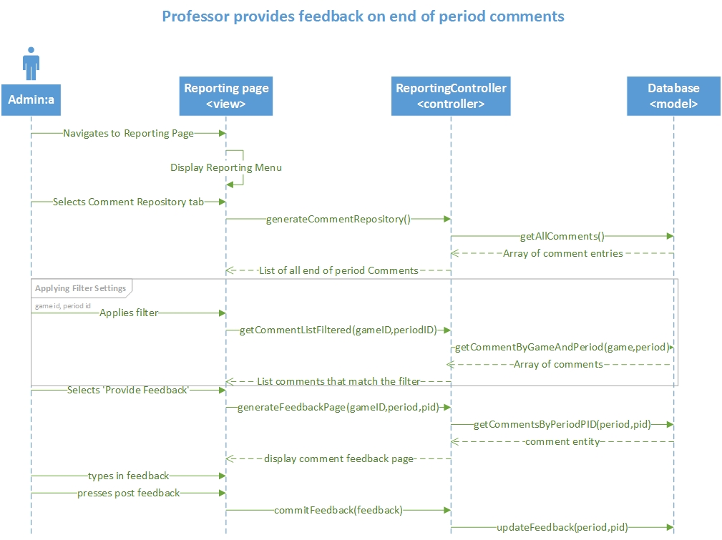
Sequence Diagrams

Slide 13
Scenario
#840 Comment Repository
Scenarios 33 - Professor navigates comment repository
Professor Cilli, is logged into the System and navigates to the Reporting page. Professor Cilli, chooses Comment repository tab, and filters the comments to a specific Game, Period, and Hotel Type. Professor Cilli, is now freely able to browse through all the Students end of period comments and provide feedback as necessary.

Slide 14
Use Cases
Use Case 33 - Professor navigates comment repository
Actor:
Admin
Pre-Conditions:
A period has finished
A Game in the database
Normal Course:
Actor logs into the System with their administrative credentials
Actor navigates to the Reporting page
Actor selects the ‘Comment Repository’ tab
Actor is Shown all the end of period comments in the System
Alternative Course
If Actor filters results after Step 4
Actor can filter results by selecting a Game, Period, or Hotel type
Post-Condition
Actor was successful
The Actors was able to browse through all the end of period comments in the System.

Slide 15
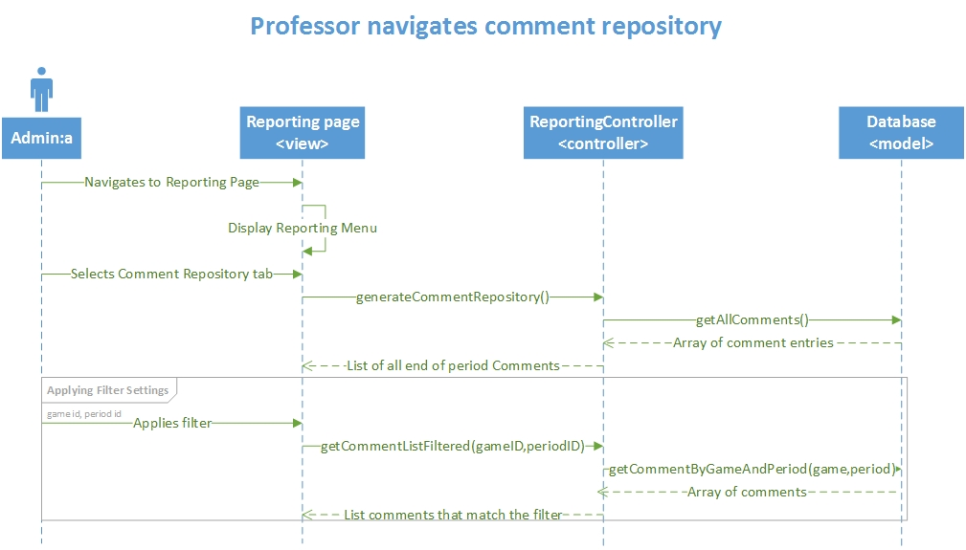
Sequence Diagrams

Slide 16
Scenario
#841 Professor Portfolio
Scenario 34 – Professor downloads a report
A period has ended for one of Professor Cilli’s, courses. Professor Cilli, will like to see how the Game played out as well as how each group responded to these changes and how they were affected by it. Professor Cilli, logs into the System and navigates to the Reporting page. Professor Cilli, selects the Reports tab, selects a desired Game, and Period. Professor Cilli, presses ‘Generate Report’ button and a pdf report is generated and can now be download to Professor Cilli’s computer.

Slide 17
Use Cases
Use Case 34 - Professor downloads a report
Actor:
Admin
Pre-Conditions:
Is logged into the System
A period has finished
A Game in the database
Normal Course:
Actor navigates to the Reporting page
Actor selects the ‘Reports’ tab
Actor selects a Game
Actor selects a period
Actor presses ‘Generate Report’
Post-Condition
Actor was successful
The Actors was able to download a detailed report for a Game/Period
Exceptions:
If Actor did not select a Game in Step 3
Actor will be unable to proceed
Actor will have to repeat Step 3
If Actor did not select a Period in Step 4
Actor will be unable to proceed
Actor will have to repeat Step 4

Slide 18
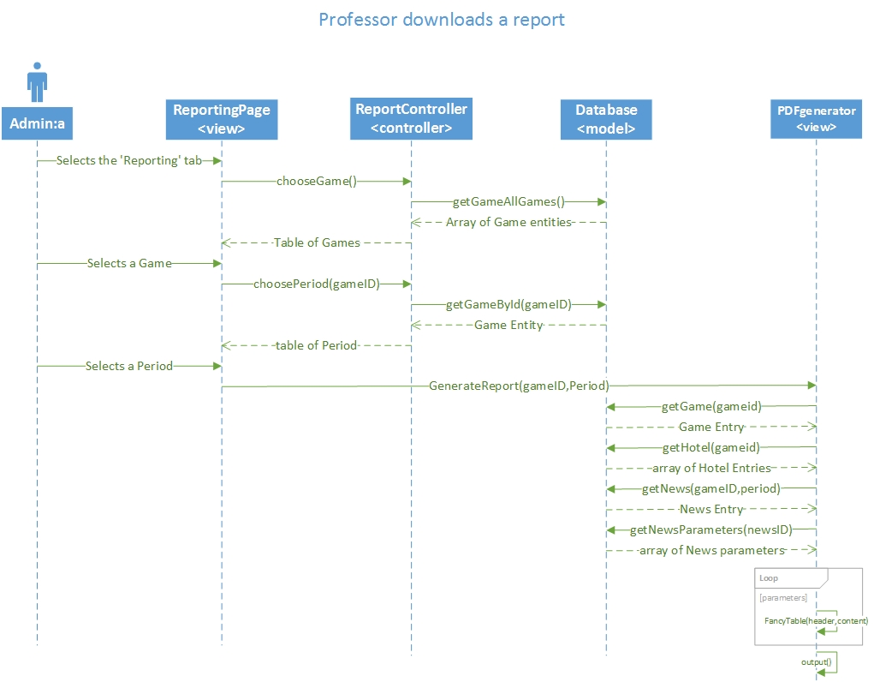
Sequence Diagrams

Slide 19
Live Demonstration
View Comment Repository
Filter results
Provide Feedback
Generate a PDF report

Slide 20
Software Testing
PHPUnit 4.8.9 by Sebastian Bergmann and contributors. Runtime: PHP 5.5.9-1ubuntu4.11Configuration: /srv/marketsim/www/Tests/phpunit.xml
ReportController
ok - ReportControllerTest::test__constructInvalidPar
ok - ReportControllerTest ::test__construcValidPar
ok - ReportControllerTest ::test_feedbackPage
ok - ReportControllerTest ::test_generateCommentTabl
ok - ReportControllerTest ::test_filterMenu
ok - ReportControllerTest ::test_commentList
ok - ReportControllerTest ::test_chooseGame
ok - ReportControllerTest ::test_selectPeriod
ok - ReportControllerTest ::test_postFeedback
Database
ok - databaseTest::test_getAllComments
ok - databaseTest::test_getCommentById
ok - databaseTest::test_getCommentByGameAndPerio
ok - databaseTest::test_updateFeedback
ok - databaseTest::test_getHotelByGameID
ok - databaseTest::test_getStudentByHotel
ok - databaseTest::test_getMarketShareByHotelAndPe
ok - databaseTest::test_getCommentByHotelAndPerio

Slide 21
Test Case
Test ID: | CreatePage81
Description: | Test ReportController function that returns a template to account page
Test Steps | Step 1 :$obj = new ReportController;
 | Step 2 :$value = "someValue";
 | Step 3: $result = "<form action='' method='post'> <div class='bs-example'>". "<div class='panel panel-default'>". "<div class='panel-body' align='center'>". "<h2>User Accounts Management</h2>"."<a href='http://marketsim-dev.cis.fiu.edu/views/reportingPage.php?button_reports=Reports' class='btn btn-primary'>Reports</a>". "<a href='http://marketsim-dev.cis.fiu.edu/views/reportingPage.php?button_commentRepository=Comment+Repository' class='btn btn-primary'>Comment Repository</a>". "</div>". "<div class='' align='center'>". "<div class='panel-footer clearfix' style='width: 1075px' >". $value. "</div>". "</div>". "</div>". "</div>". "</form>";
 | Step 4:>assertEquals($result, $obj->CreatePage($value));
Tester: | Javier Andrial
Result: | Pass

Slide 22
Strategic Marketing Simulator 1.0
Questions?

